Slide 1
UNIFESP X-ray Body Part Classifier
Presenter : Jennis(Chingtzu) Huang
2022 July

Slide 2
TABLE OF CONTENTS
01.
Introduction
02.
Method
03.
Result
04.
Discussion
Notes:
The presentation is divided into four main sections

Slide 3
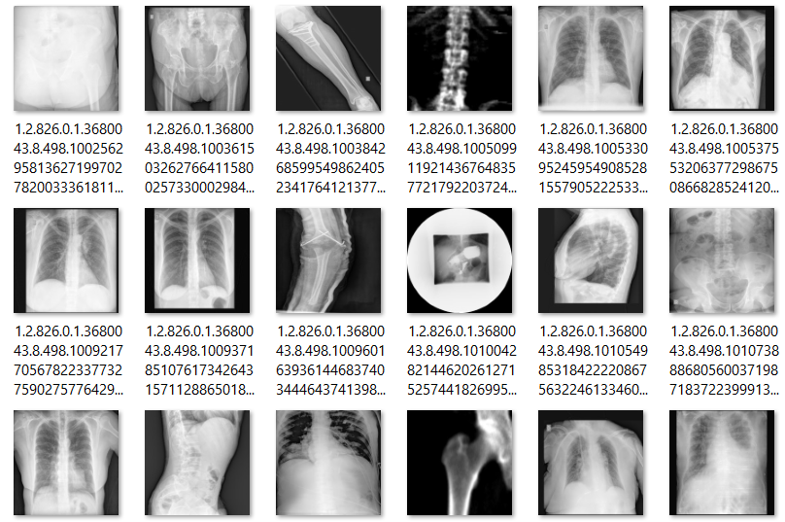
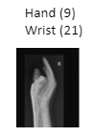
Introduction of the dataset
Extract datasets from PACS filtering by the Study Description
multiple body parts
empty exams.
Purpose: Automatically identify body parts
308 MB (1738 images)
File Format: DICOM(308MB) JPG(75MB)
Image size 128x128 pixels
Notes:
In many hospitals, when a physician orders multiple imaging exams one accession number is created for each body part (eg. knee, ankle, and leg), but the registration for the correspondent images are often incorrect within each accession number
if you create a model to classify some diseases in one body part, model deployment in clinical practice will be almost impossible. For one thing, imagine we created a model to detect pneumonia in chest x-rays. To deploy that model we need to ensure we only get chest x-rays. Otherwise, we may end up trying to diagnose pneumonia from a skull x-ray, which does not make any sense.
That is a major concern because if you want to extract a knee dataset from PACS filtering by the Study Description, you will often extract exams with multiple body parts and sometimes extract empty exams
The algorithm you are challenged to create should be able to automate the identification of the body part in the image, making it possible to create more datasets and deploy pipelines.
.

Slide 4
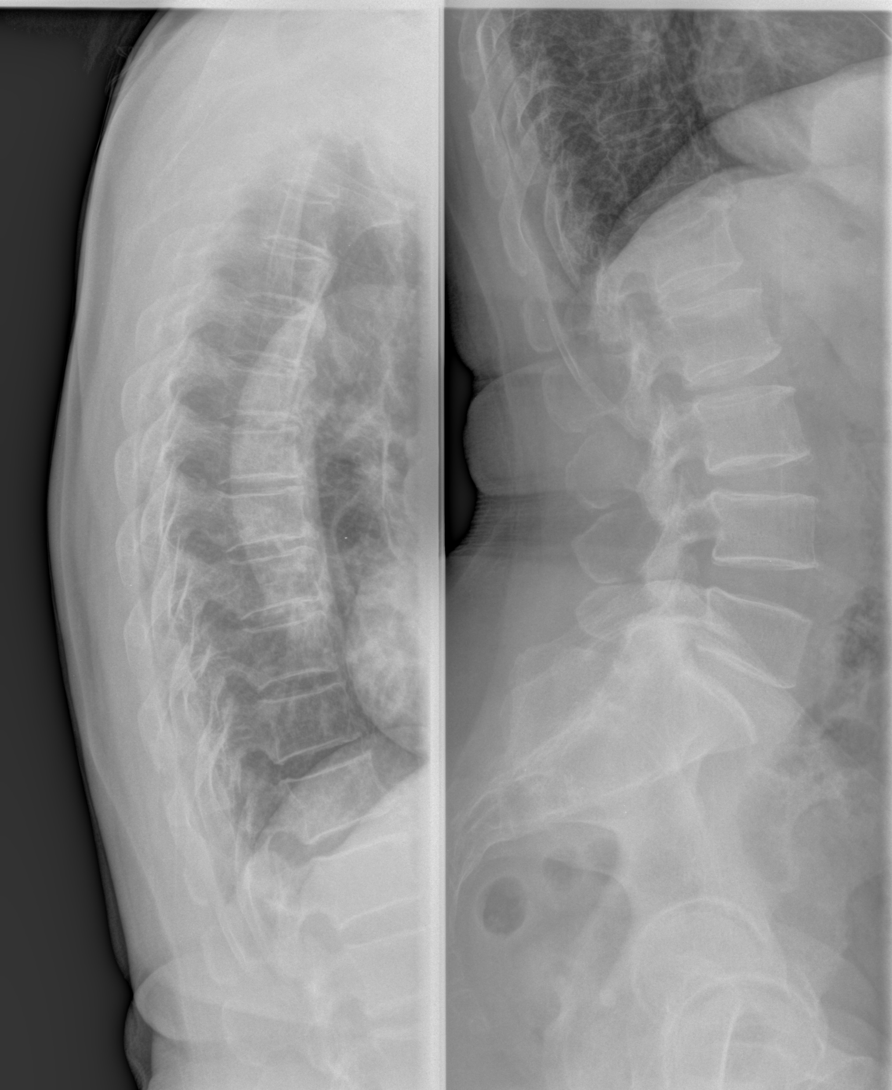
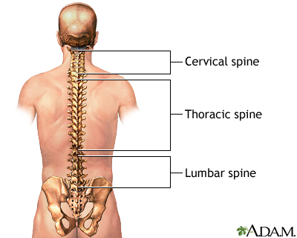
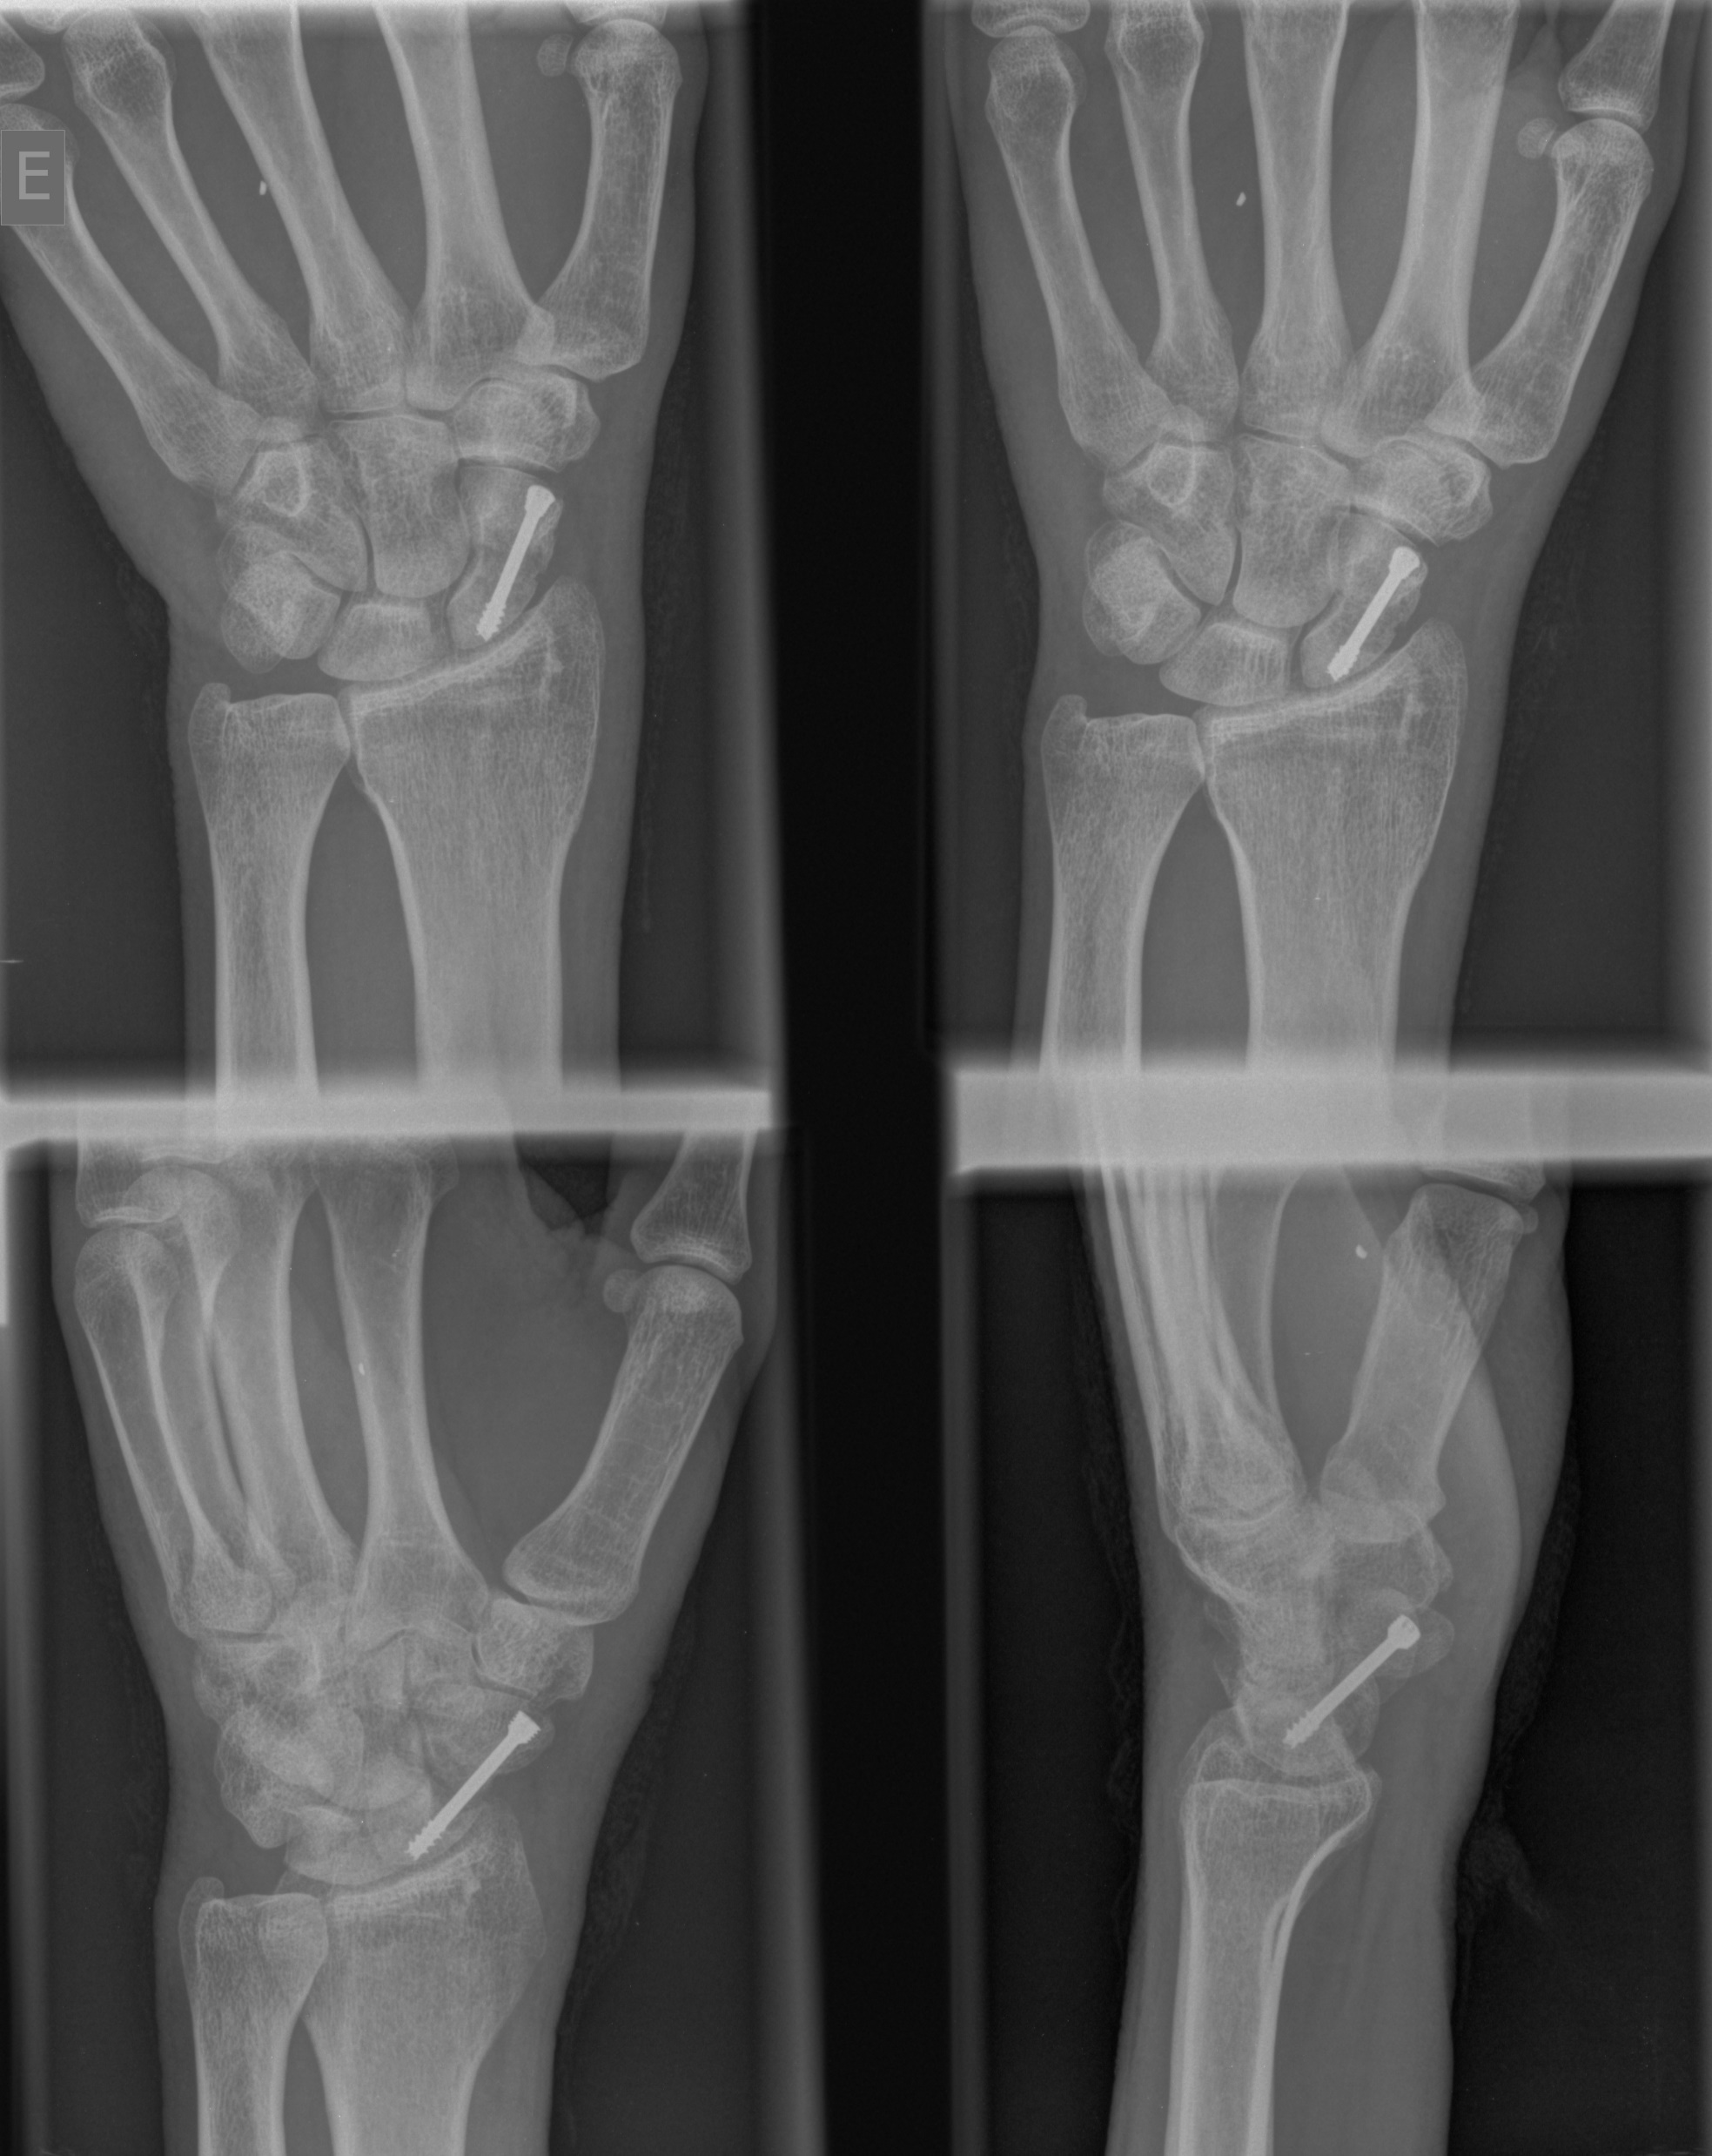
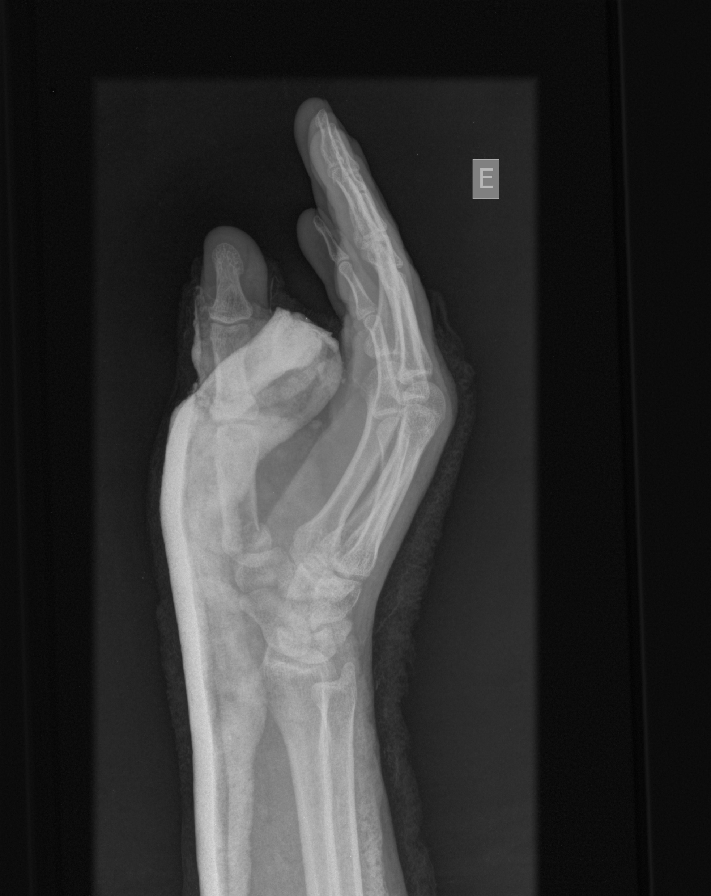
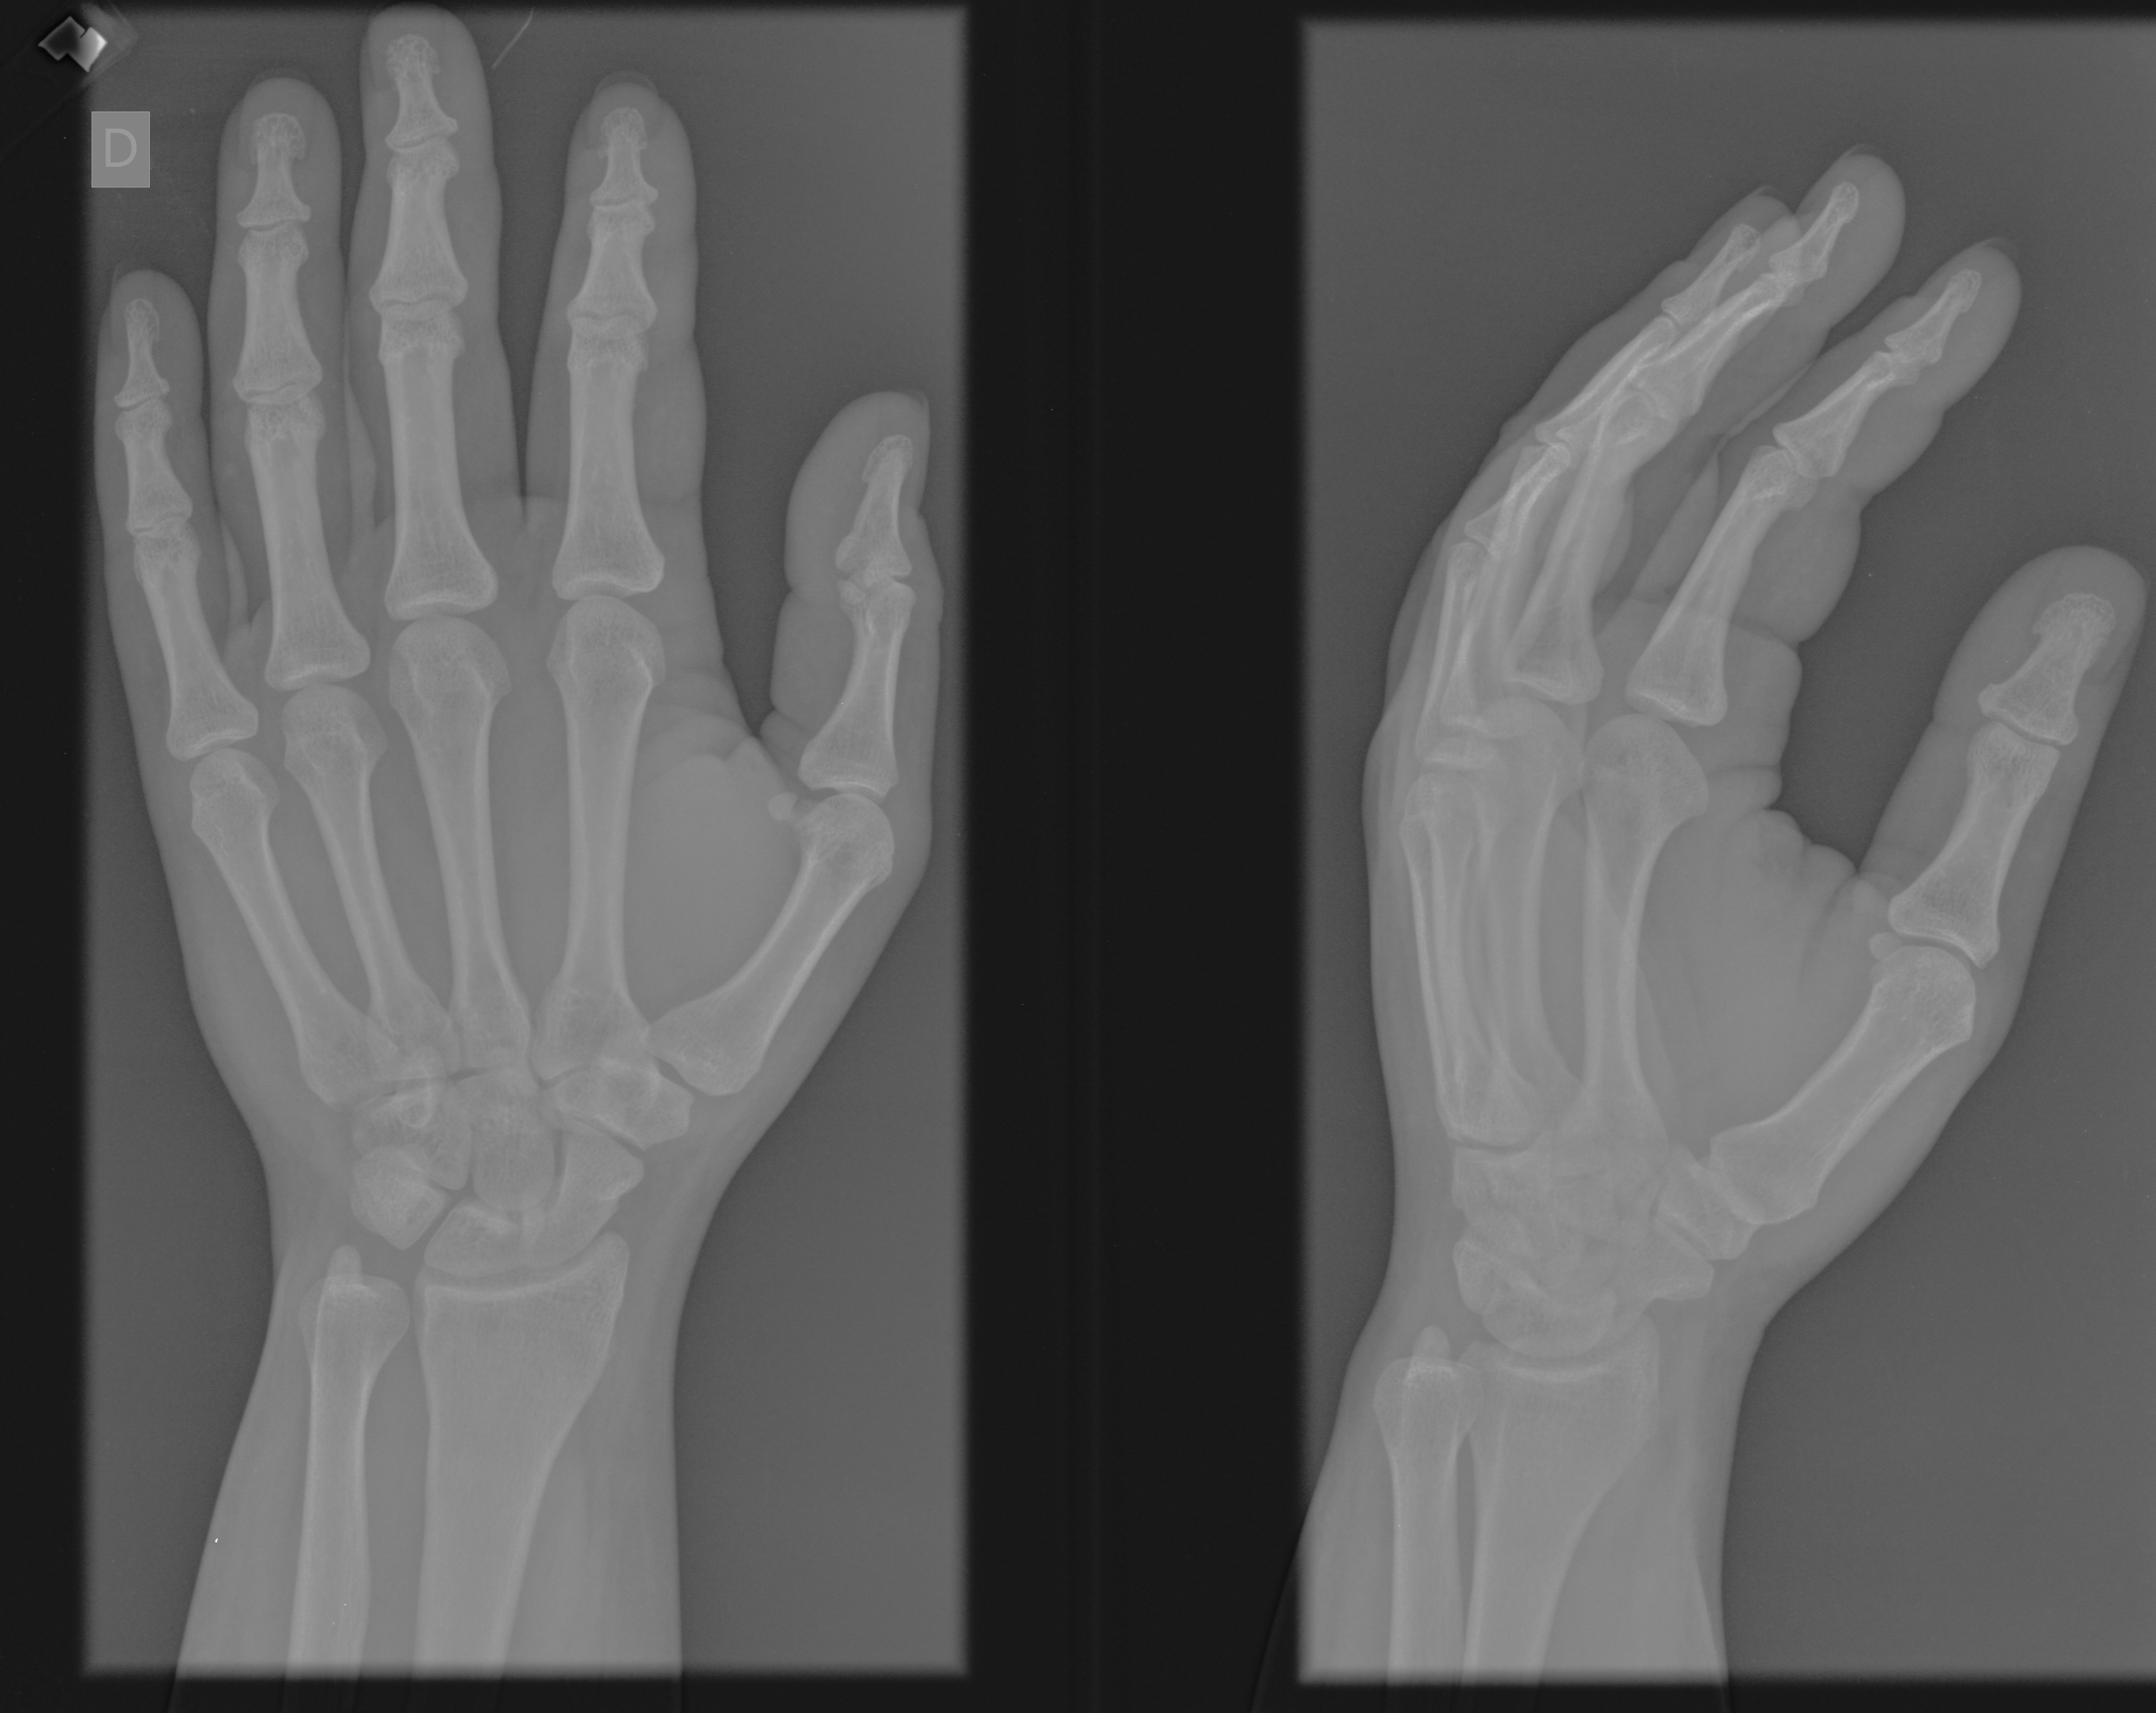
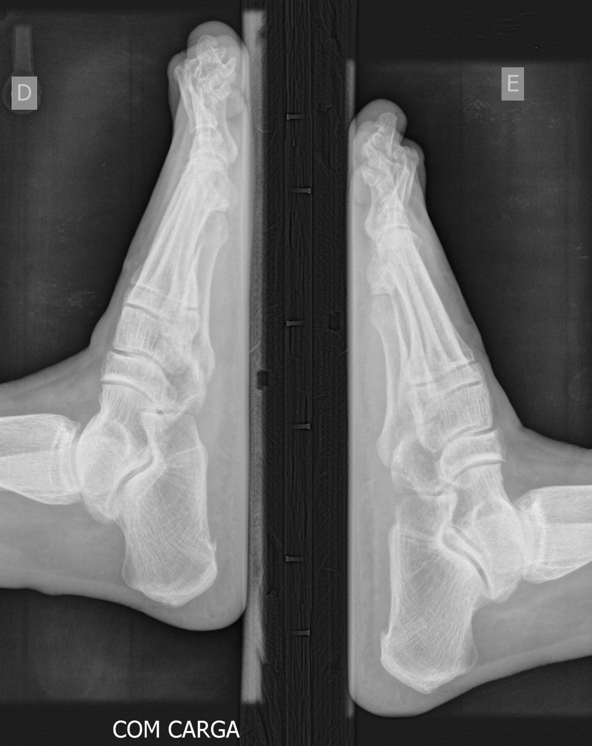
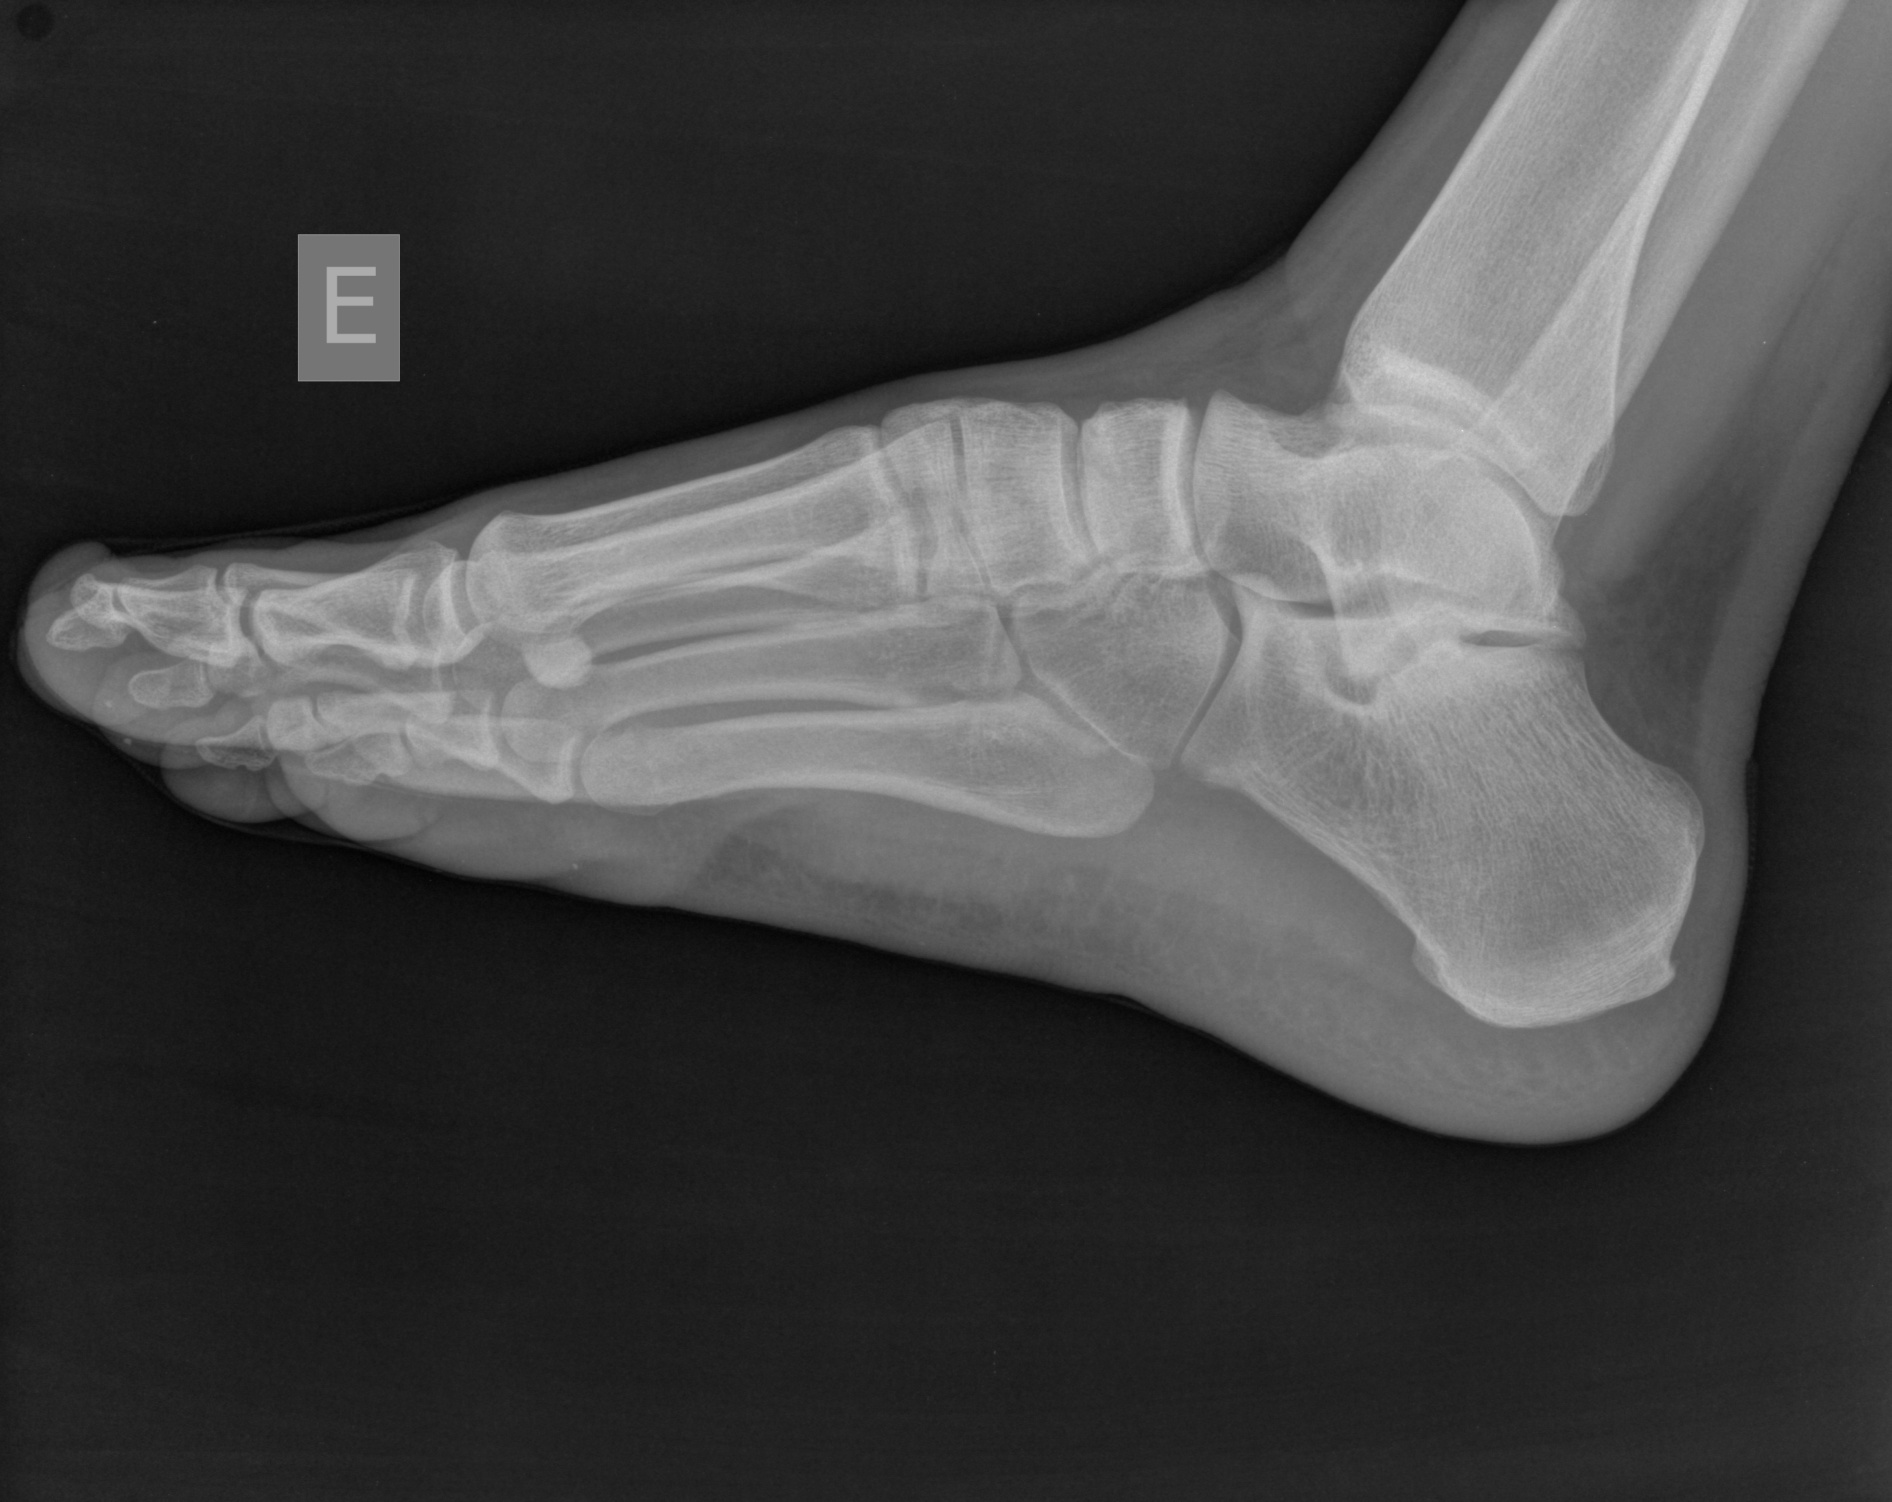
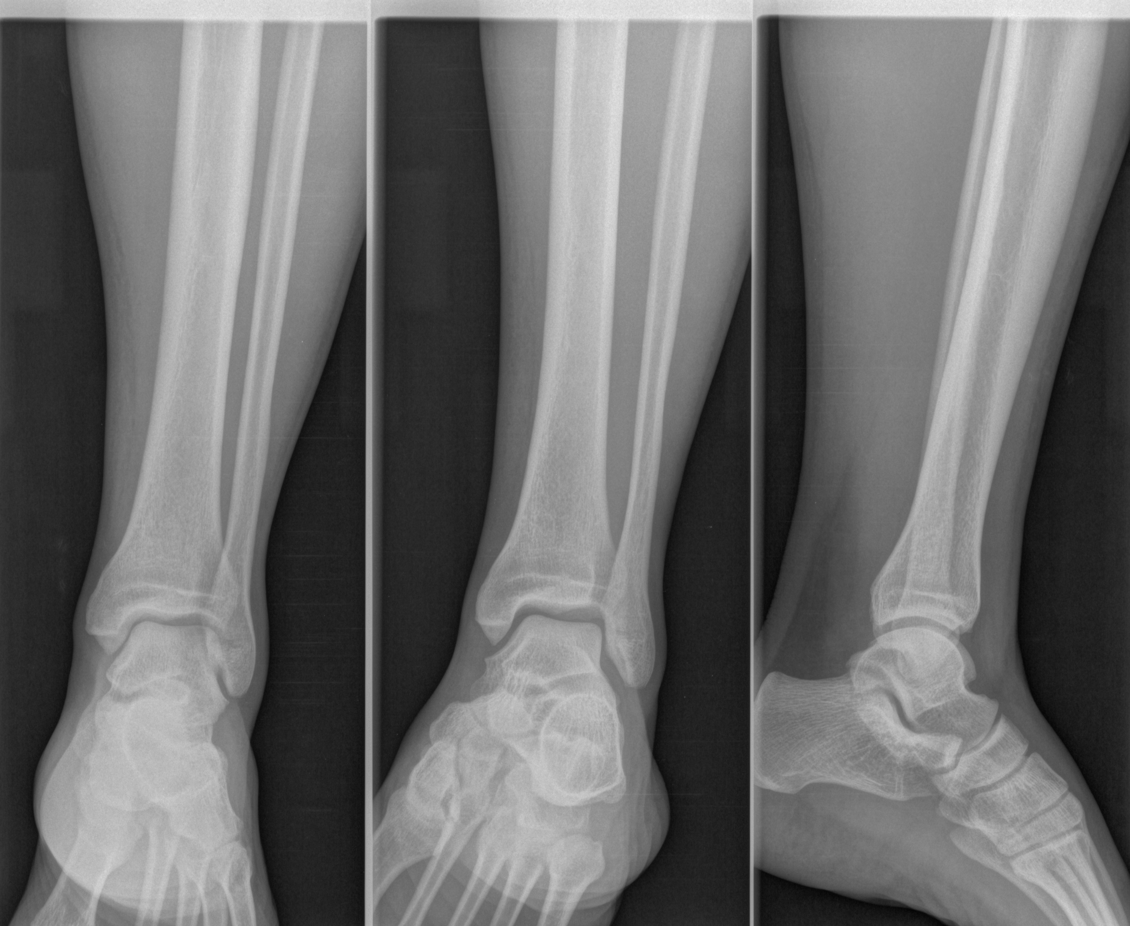
Challenges: One image with the multiple body labels
Type 1
Lumbar Spine (13)
Thoracic Spine(20)
Thoracic Spine(20)
Lumbar Spine (13)
Type 3
Wrist (21)
Hand (9)
Wrist (21)
Hand (9)
Type 2
Feet(6)
Ankle (1)
Feet (6)
Ankle (1)
Ankle (1)
Feet (6)
referance

Slide 5
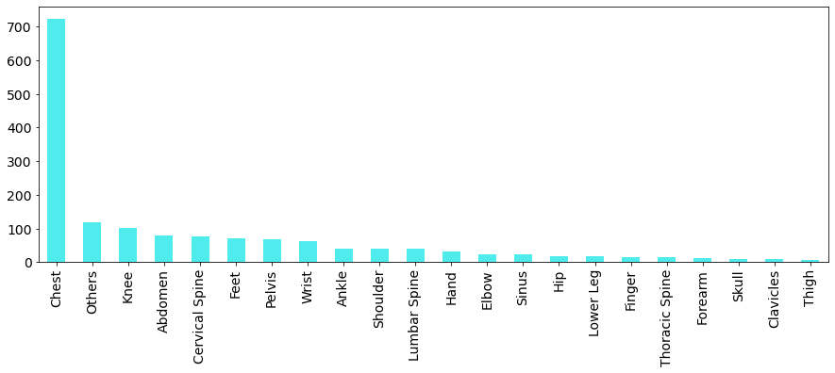
Introduction of the dataset
22 types of body
Ignoring the pics with multi-label first
Original 1738 pics – 132 multi-label pics =1606 pics(training set)
Notes:
First step, we ignore the pictures which has multiple-label(hard to deal with it)

Slide 6

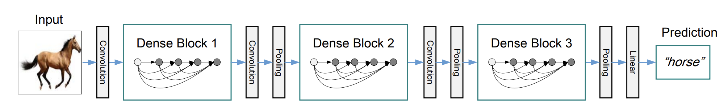

Method 1
Densenet
VGG
Notes:
Pretrained model in Keras API, 2 best image DL pretrained artchitecture from literature and Kaggle discussion forum

Slide 7
Method 2
Combination of 2 pretrained model
DenseNet
VGG
Chest
(724)
All X-ray
images
VGG 19
Others(Noise)
(120)
The rest of body parts
(894)
20 body parts
DenseNet 169
Notes:
.

Slide 8
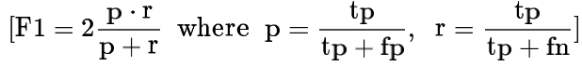
Result
Evaluation:
Architecture | Data Augmentation | Score at Kaggle
DenseNet 121 (41 classes) | zoom, horizontal flip, shear | 0.883
DenseNet 169, 100%trainig (41 classes) | zoom, horizontal flip, shear | 0.892
DenseNet 201 (22 classes with balanced sample weight) | zoom, horizontal flip, shear | 0.872
VGG 19+DenseNet 169 | zoom, horizontal flip, shear | 0.865

Slide 9
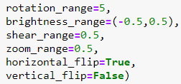
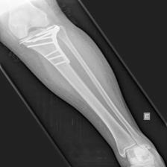
Discussion
1.Overfitting:
DenseNet 201(too much layers)
2.Data Augmantation selection
3.Sample Weights didn’t improve the score a lot
Vertical flip
Horizontal flip
Notes:
Augmentation: not every method can improve the accuracy, some would mislead the neural network
In addition, sample weight implementation didn’t help a lot, it might due to the sample size

Slide 10
Reference
Optimal hyperparameter selection of deep learning models for COVID-19 chest X-ray classification Adeyinka P. Adedigba, Steve A. Adeshina, [...], and Abiodun M. Aibinu, https://www.ncbi.nlm.nih.gov/pmc/articles/PMC8057926/
The best vision models for fine-tuning, https://www.kaggle.com/code/jhoward/the-best-vision-models-for-fine-tuning
VGG, https://doi.org/10.48550/arXiv.1409.1556
DenseNet, https://doi.org/10.48550/arXiv.1608.06993
The UNIFESP X-Ray Body Part Classification Dataset(Small size), https://www.kaggle.com/datasets/felipekitamura/unifesp-xray-bodypart-classification

Slide 11
THANKS!
Any questions?
Contact:
minijennis@gmail.com
Please keep this slide for attribution

